Slide 1
PCA

Slide 2
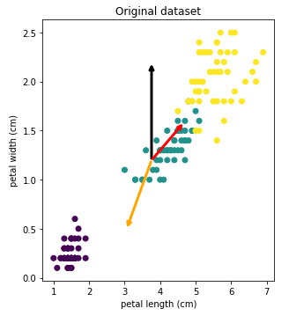
Principal Component Analysis
Project from our original dataset onto a lower dimensional subset defined by new coordinate axes, z_{i}
Method for finding the best lower dimensional coordinate space to project onto

Slide 3
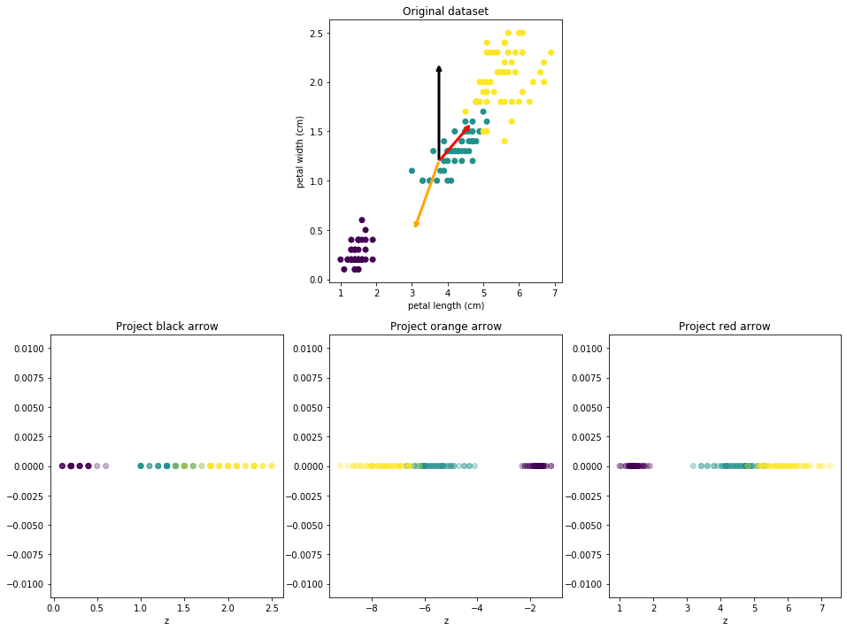
Principal Component Analysis
Project from our original dataset onto a lower dimensional subset defined by new coordinate axes, z_{i}
Method for finding the best lower dimensional coordinate space to project onto

Slide 4
Principal Component Analysis
Method
Variance lets us separate our datapoints
So we want to preserve the variance
This method also minimize distance between new and old dataset (want new dataset to be very similar to old dataset)

Slide 5
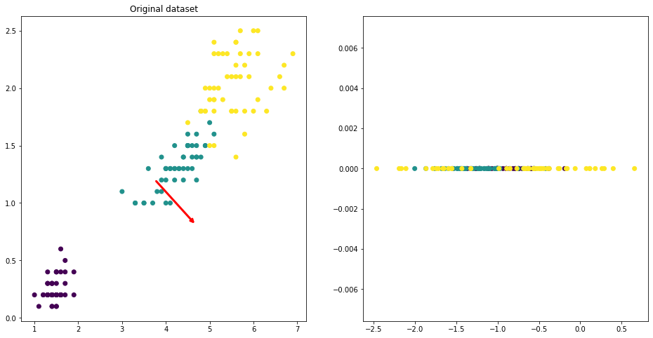
Principal Component Analysis
Method
Variance lets us separate our datapoints
Preserve the variance
Minimize distance between new and old dataset (want new dataset to be very similar to old dataset)

Slide 6
Principal Component Analysis
Method
Variance lets us separate our datapoints
Preserve the variance
Minimize distance between new and old dataset (want new dataset to be very similar to old dataset)

Slide 7
Principal Component Analysis
Method
Principal component
Each new axis is called a principal component, starting with z₁, the first principal component, over z_{i}, the ith principal component

Slide 8
Principal Component Analysis
Method
Principal component
Reducing Dimensions
To reduce dimensions we just project our data onto the hyperplane defined by our principal components

Slide 9
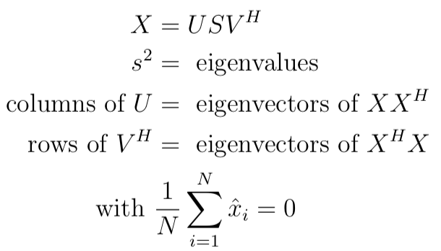

Principal Component Analysis
Our principal components are then the first d rows of V^{H}
P - projected down to d dimensions
X is centered around 0
Eigenvalue coefficients give us degree of explained variance by each corresponding principal component

Slide 10

Reconstruction
Simply multiply our projected matrix by the our original eigenvector matrix

Slide 11
Evaluating hyperparameters
Reconstruction error - MSE of distance between original points vs reconstructed points

Slide 12
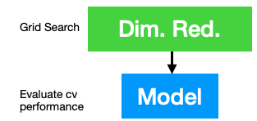
Evaluating hyperparameters
Reconstruction error - MSE of distance between original points vs reconstructed points
Grid search with supervised learning model as second step and dimensionality reduction as first step

Slide 13
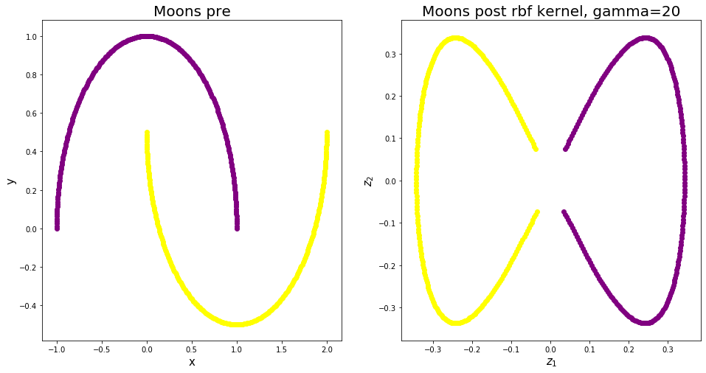
Kernel PCA
Project our data to a d dimensional space, where d >=N, with N being our current dimensions
In a higher dimensional space our data can almost always be linearly separated, and we can separate our data into clusters using some suitable hyperplane

Slide 14
Kernel PCA
This hyperplane depends on the kernel we use, and using the same kernel trick we also had for SVMs, we can calculate the resulting projections of our data
This lets us define non-linear hyperplanes to project our data onto

Slide 15
Reconstruction
Unlike linear PCA, in kernel PCA we never compute the components, just the projections
For reconstruction we then have to perform extra fitting to find points in our original space that lie close to our project points in the higher dimensional space (inverse transform method)

Slide 16
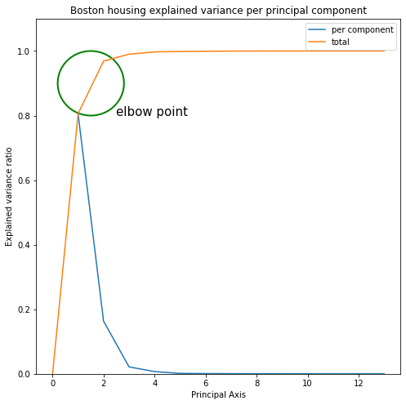
Choosing d
Elbow point on curve
Cumulative explained variance
Visualization needs

